Slide 1
COURSERA CAPSTONE IBM Applied Data Science Capstone Finding a Better Place in Etobicoke, Toronto By- Akshay Jadhav

Slide 2
Business Problem
The objective of this capstone project is to analyse and select the best locations in the city of Etobicoke, Toronto to shift to new venue. Using data science methodology and machine learning techniques like clustering, this project aims to provide solutions to answer the business question:
It will help people making smart and efficient decision on selecting great neighborhood out of numbers of other neighborhoods in Etobicoke, Toranto.

Slide 3
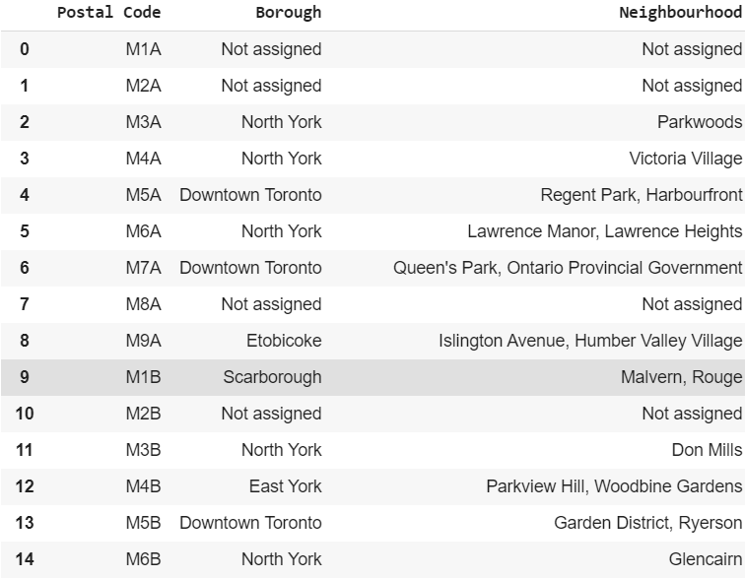
Dataset Overview

Slide 4
To solve the problem, we will need the following data:
•List of neighbourhoods in of Etobicoke, Toranto. This defines the scope of this project which is confined to the city of of Etobicoke,, the best city of the country.
•Latitude and longitude coordinates of those neighbourhoods. This is required in order to plot the map and also to get the venue data.
•Venue data, particularly data related to daily requirements. We will use this data to perform clustering on the neighbourhoods.

Slide 5
Methodology
Firstly, we need to get the list of neighbourhoods & postal codes in the city of Etobicoke, Toranto. Fortunately, the list is available in the Wikipedia page (https://en.wikipedia.org/wiki/List_of_postal_codes_of_Canada:_M). We will do web scraping using Python requests and beautifulsoup packages to extract the list of neighbourhoods and postal codes data. However, this is just a list of names. We need to get the geographical coordinates in the form of latitude and longitude in order to be able to use Foursquare API. To do so, we will use the wonderful Geocoder package that will allow us to convert address into geographical coordinates in the form of latitude and longitude. After gathering the data, we will populate the data into a pandas DataFrame and then visualize the neighbourhoods in a map using Folium package. This allows us to perform a sanity check to make sure that the geographical coordinates data returned by Geocoder are correctly plotted in the city of Toronto.

Slide 6
Next, we will use Foursquare API to get the top 100 venues that are within a radius of 2000 meters. We need to register a Foursquare Developer Account in order to obtain the Foursquare ID and Foursquare secret key. We then make API calls to Foursquare passing in the geographical coordinates of the neighbourhoods in a Python loop. Foursquare will return the venue data in JSON format and we will extract the venue name, venue category, venue latitude and longitude. With the data, we can check how many venues were returned for each neighbourhood and examine how many unique categories can be curated from all the returned venues. Then, we will analyse each neighbourhood by grouping the rows by neighbourhood and taking the mean of the frequency of occurrence of each venue category. By doing so, we are also preparing the data for use in clustering. Since we are analysing the “top venues” data, we will filter the “top venues” as venue category for the neighbourhoods.

Slide 7
Lastly, we will perform clustering on the data by using k-means clustering. K-means clustering algorithm identifies k number of centroids, and then allocates every data point to the nearest cluster, while keeping the centroids as small as possible. It is one of the simplest and popular unsupervised machine learning algorithms and is particularly suited to solve the problem for this project. We will cluster the neighbourhoods into 3 clusters based on their frequency of occurrence for “venues”. The results will allow us to identify which neighbourhoods have higher concentration of shopping malls while which neighbourhoods have more number of amenities. Based on the occurrence of amenities in different neighbourhoods, it will help us to answer the question as to which neighbourhoods are most suitable to choose a venue.

Slide 8
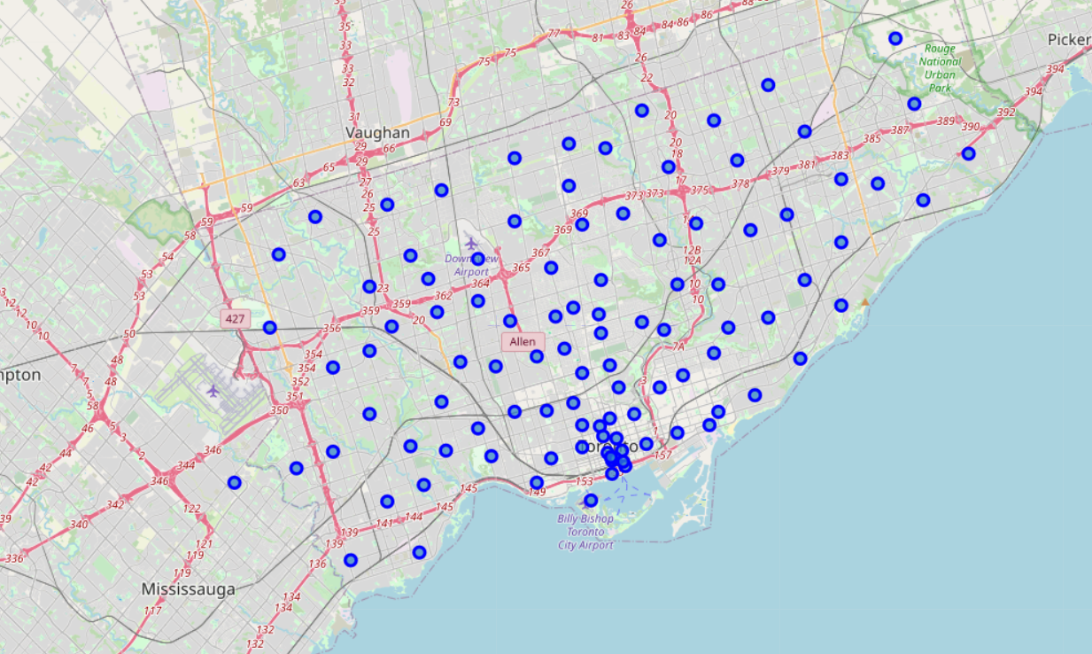
Venues in toronto

Slide 9
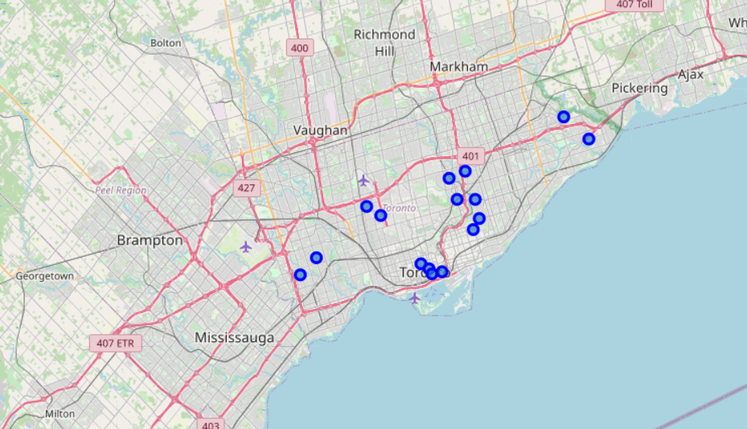
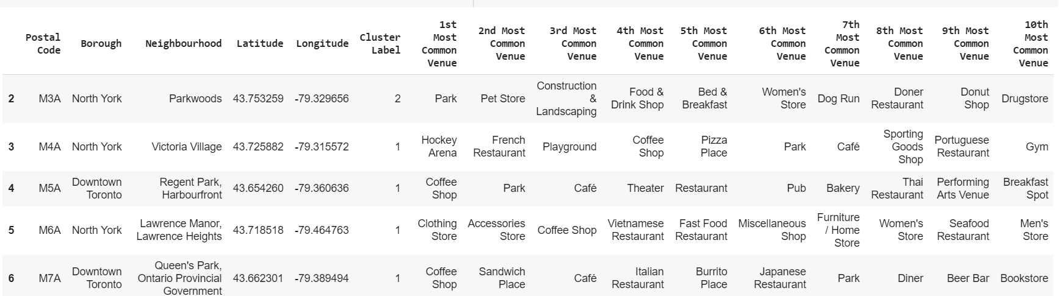
Results
The results from the k-means clustering show that we can categorize the neighbourhoods into 3 clusters based on the frequency of occurrence for “best places”:

Slide 10
Conclusion
In this project, we have gone through the process of identifying the business problem, specifying the data required, extracting and preparing the data, performing machine learning by clustering the data into 3 clusters based on their similarities, and lastly providing recommendations to the relevant stakeholders i.e.to people who are willing to choose a prfect location. To answer the business question that was raised in the introduction section, the answer proposed by this project is: The neighbourhoods in cluster 1 are the most preferred locations to choose a location .

Slide 11
THANK YOU

